Slide 1

Welcome
“פרויקט גמר שיתוף הנדסת תוכנה ותעשייה וניהול”
LDS – Laser Detect Systems
HOUSE FOR SUBSTANCES DETECTION
TECHNOLOGIES, APPLICATIONS & CONOP

Slide 2





ABOUT US
Time Line
Founded In 2004
Public In 2009
Private In 2010
Wide Distribution 2015
Products & Solutions
Detectors
Detection Products
Integrated Solutions
Technology
Lasers
IMS
Chemicals
Market
R&D
Military
Security & HLS

Slide 3
OUR MISSION
Lasers
IMS
Chemicals
Under Vehicle Inspection
TECHNOLOGY
Explosives
Precursors
Drugs
Poisons
Traces
Vapors
Liquids & Gels
CAPABILITIES
Risk Analysis
Site Surveys
CONOP
Training
Intelligence/
Interception
CONOPS
From Detection to Interception

Slide 4






APPLICATIONS
Check points & Borders
Mass crowd
Events
Airports Security
Customs inspection
Seaport
security
Mass Transportation
Critical Infrastructure Protection

Slide 5


Slide 6
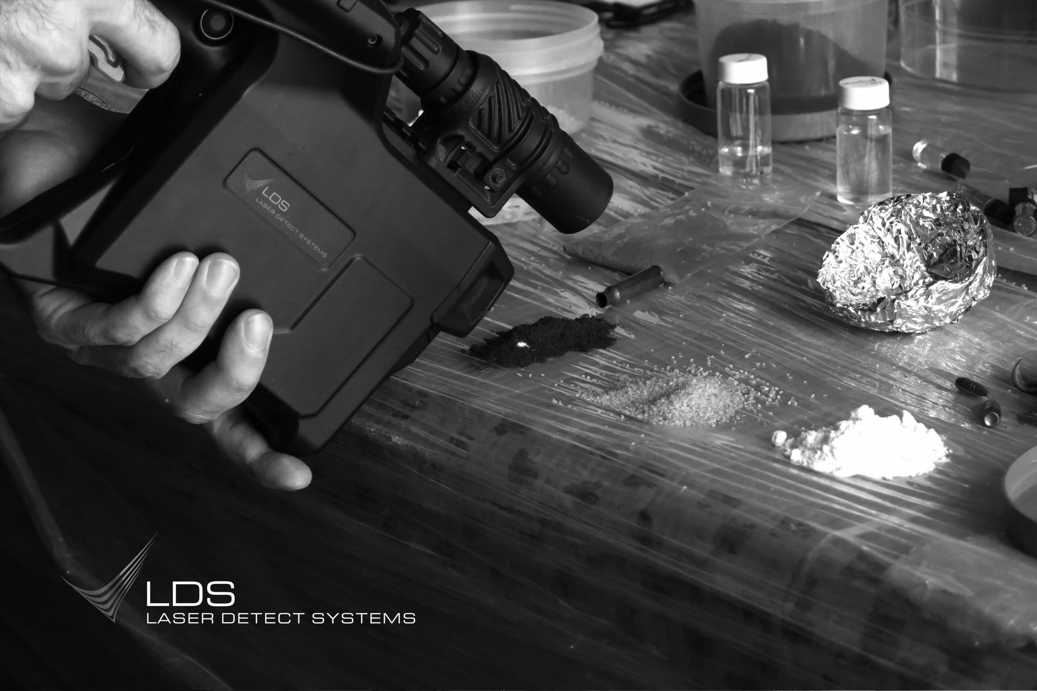
Laser Technology THE CHALLENGE
Identification & detection of substances that looks INNOCENT
But may contain
DANGEROUS SUBSTANCES

Slide 7


Laser Technology THE CHALLENGE
Or are there liquid explosive mixed?
Is This Water?
Does this pill contain only paracetamol?
Or a mixture of large amount of cocaine
Is it only sugar?
Or massive amount of heroine is inside

Slide 8

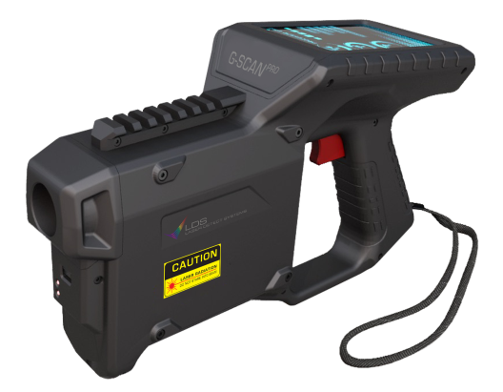
TODAY’S IDENTIFICATION SOLUTIONS
Do Nothing
Chemical testers
Sniffers
Laboratories
Rapid flow
Minimum delay
Minimum inconvenient
High Risk
Very precise
Hard to use
Slow processing – affects flow
Short lifetime once opened
Limited database
Sensitive to temperature and operating technic
Not relevant for liquids
Accurate
Certified
Not in real time
High cost
Long time analysis time

Slide 9
Raman Spectroscopy Portable Laser Detectors
LDS Core Technology

Slide 10

LASER IDENTIFICATION PROCESS
Engagement
01
A laser source illuminates the suspected material.
The light strikes the molecules and scatters.
The scattered light is collected by the spectrometer.

Slide 11


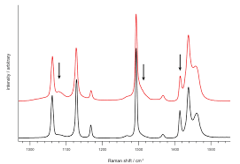
LASER IDENTIFICATION PROCESS
Analysis
02
Molecular fingerprint is generated
(Raman spectra).
The spectrum is compared with previously recorded Raman signatures of various substances.

Slide 12

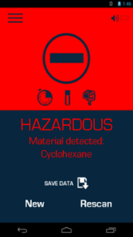
LASER IDENTIFICATION PROCESS
Outcome
03
The computing unit generates True / False result.
A match alerts the operator of hazardous substances residue.

Slide 13
EXTENDABLE DATABASE
Locally.
Externally.

Slide 14

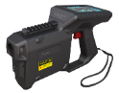

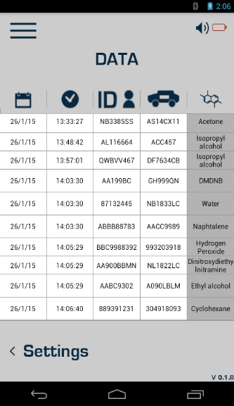


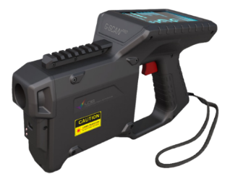
LOG EVENT
Intelligence Center
Enter password
Fill out the report
Data is saved on cloud

Slide 15
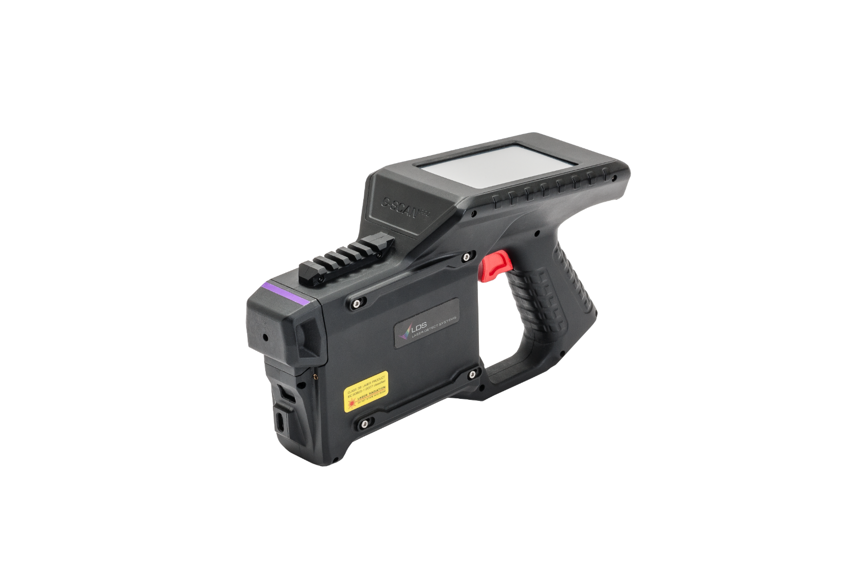
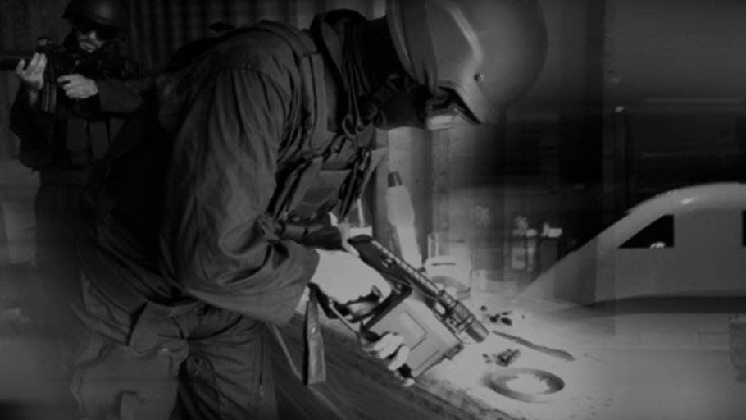
G-SCAN^{PRO}

Slide 16
G-SCAN^{PRO} HANDHELD HAZARDOUS SUBSTANCES LASER DETECTOR
Detection of wide variety of hazardous substances
in forms of liquid, bulk or powder
Real time, Rapid results ~5sec
Designed for the outdoor
Highly Operational & Light weight <1.85kg
Long operating time >8 hrs

Slide 17
G-SCAN^{PRO} HANDHELD HAZARDOUS SUBSTANCES LASER DETECTOR
Easy to use, low false alarm rate, Short training
Ready to go immediately. No warmup time
Minimal maintenance
Extendable database. Locally, Externally
High profile, Deterrence
Not effected by external Environment

Slide 18
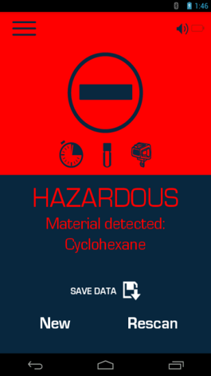
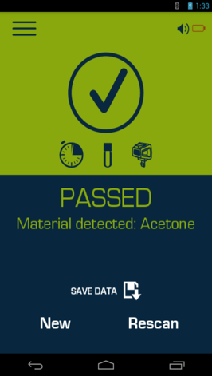
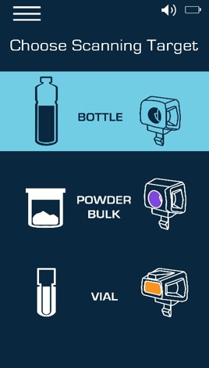
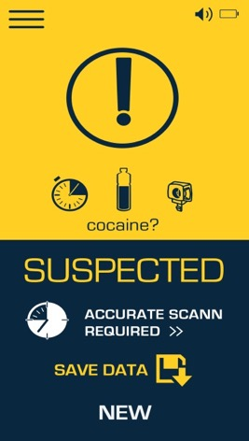
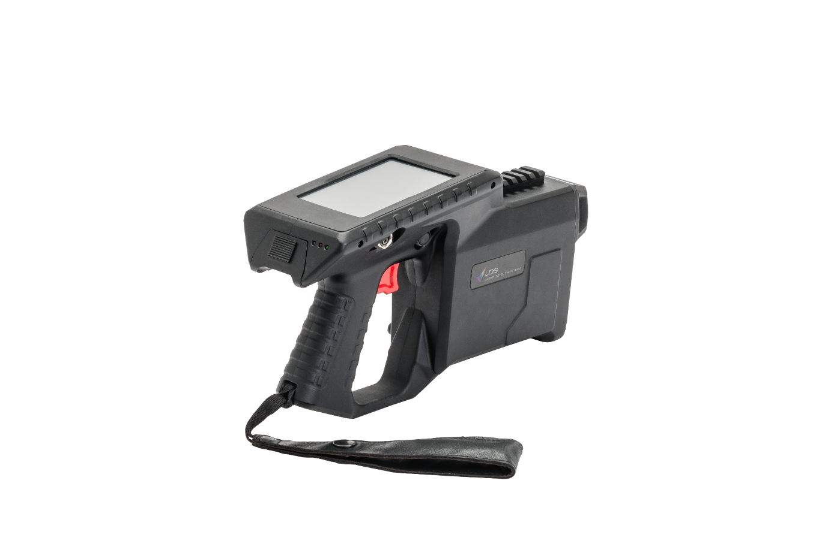
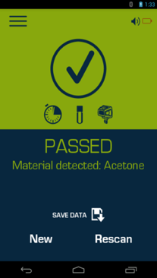


INTUATIVE USER INTERFACES
User level
Simple Operation
Visible and vocal

Slide 19
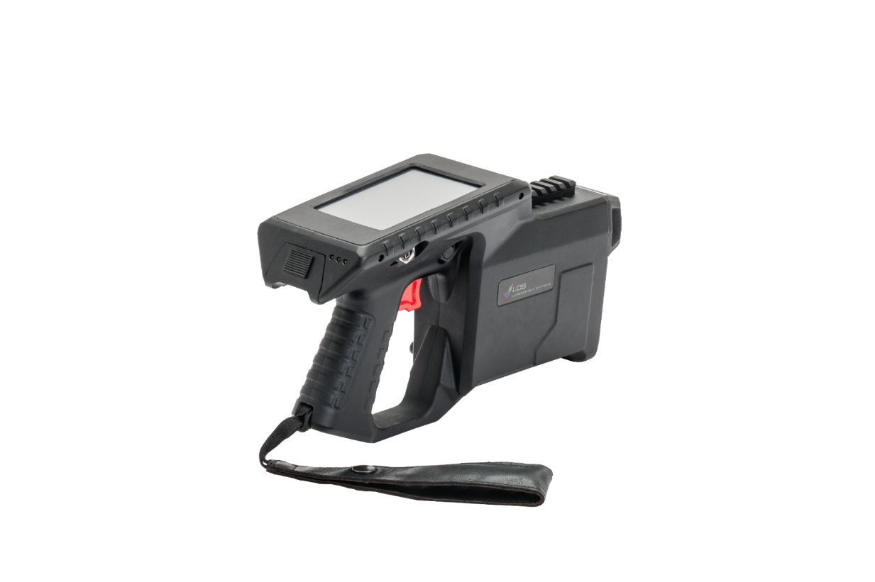
INTUATIVE USER INTERFACES
Professional level
Analysis of the Raman Graphs is available with sophisticated Analysis software

Slide 20

THE OPERATIONAL CYCLE
01
05
Intelligence
G-SCAN^{pro}
Effectively Supports the operational cycle
Interception
G-SCAN^{pro}
OPERATIONAL CYCLE
02
Deterrence
04
Identification
03
Detection

Slide 21

DETERRENCE
01
05
Intelligence
Interception
G-SCAN^{pro}
OPERATIONAL CYCLE
02
04
Deterrence
Identification
03
Detection
Challenge:
High profile sensors
Cover wide area and big volume
Constant change of deployment
LDS Response:
High visibility. Future looks. Unfamiliar Technology
Mobile sensor, long operating time

Slide 22






DETECTION
01
05
Intelligence
Interception
G-SCAN^{pro}
OPERATIONAL CYCLE
02
04
Deterrence
Identification
03
Challenge:
Real time outdoor Identification
Accurate. Technology based detection
Mixtures & new types of drugs and explosives
LDS Response:
Univalent. 99% Verification in real time
Indoor/Outdoor. Environment has low affect on its performance
Quick analysis & Response time
Detection

Slide 23
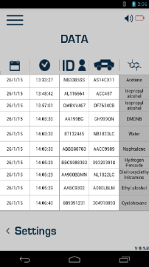
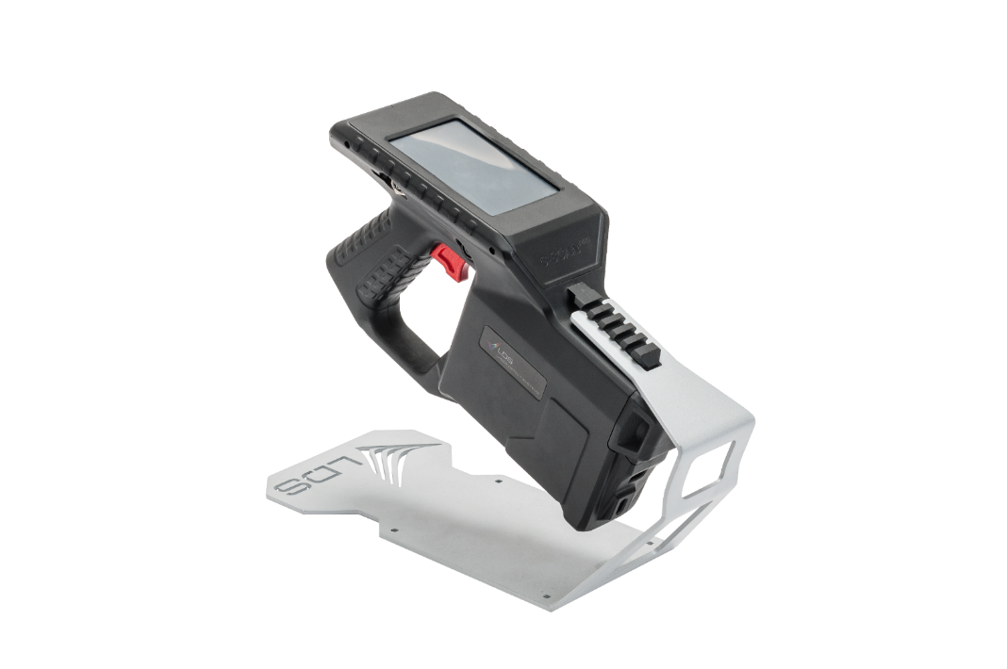
IDENTIFICATION
01
05
Intelligence
Interception
G-SCAN^{pro}
OPERATIONAL CYCLE
02
04
Deterrence
Identification
Challenge:
Identify wide range of Hazardous substances
Implement emerging substances
Document & Analyze (Carrier, substances, time, routes, places)
LDS Response:
Wide substances database
Extendable database
Log event module
03
Detection

Slide 24
Unique Selling Points

Slide 25
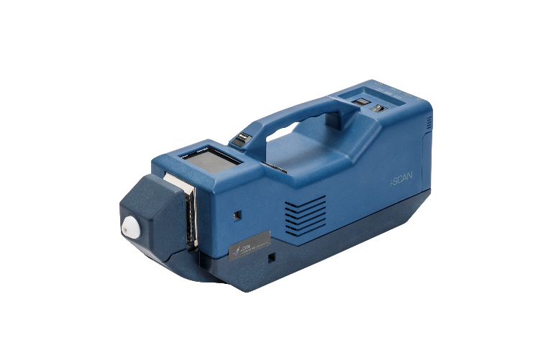
Laser compere to IMS
Vs.
Advantages
No Warn up- immediately ready to work.
No consumables.
No Calibration.
Minimal environmental effect at the outdoor.
New operational concept – Deterrence.
Liquids (+ Bulk & Powders).
Via Container .
Limitations:
No gas- completers technology
No traces

Slide 26





Device level- advantages
Quick analysis time. Laser type
Via Container
Substances Library
Outdoor, Highly operational (SwaP, Design)
Wide. Unique
Extendable (Hugh)
Upgradeable
Liquids (+ Bulk & Powders)

Slide 27

Promotion, sales resistance &
Set of expectations with the Costumer
Remote. not needed for Narcotics detection
Penetration via Containers
Dark materials & luminance
Support & Maintenance

Slide 28

THANK YOU

